Slide 1
Tutorial 5

Slide 2
Topics
BJT Biasing techniques
JFET current equation
CE amplifier

Slide 3
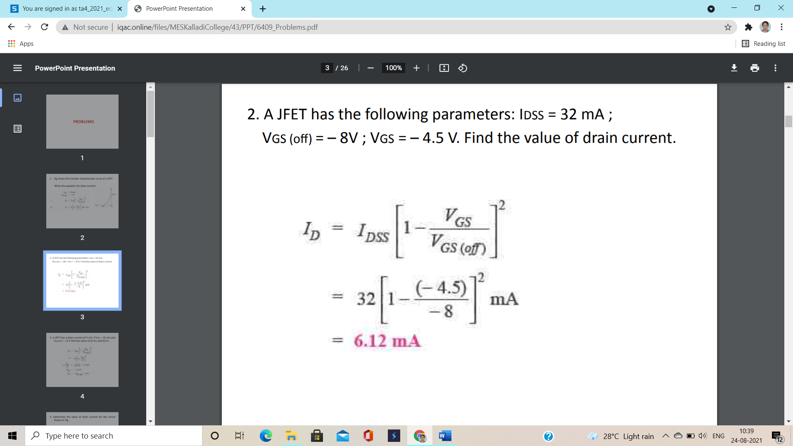
(1)

Slide 4
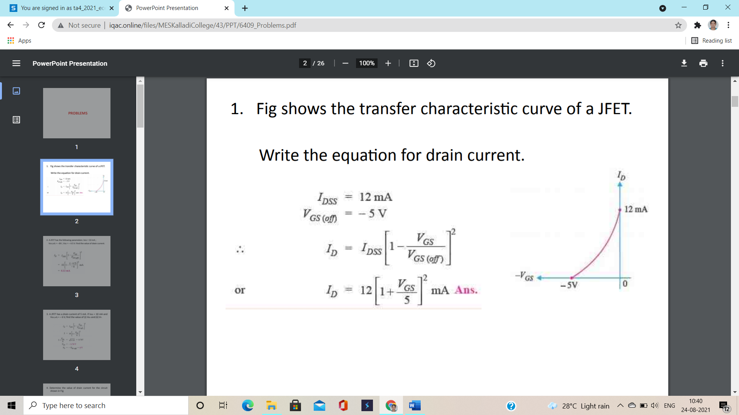
(2)

Slide 5
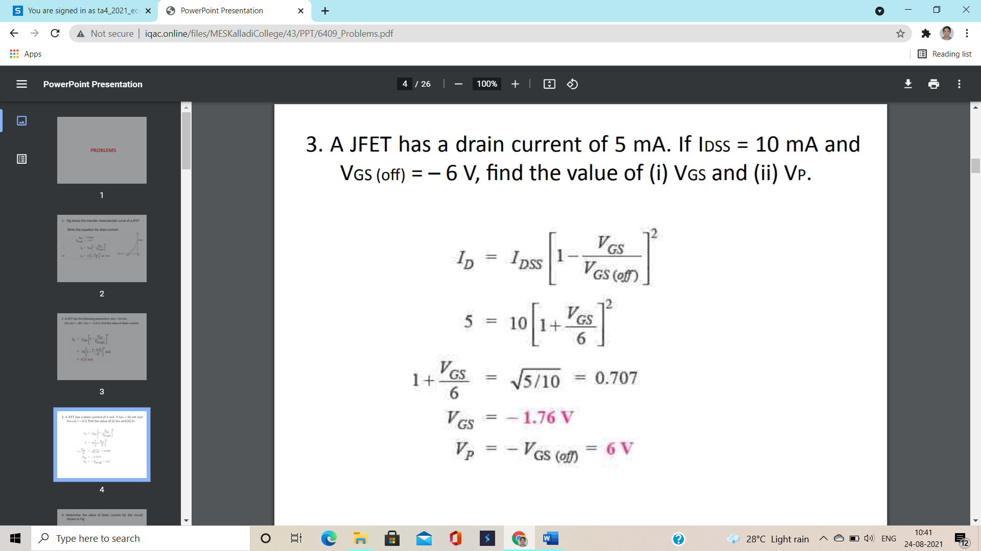
(3)

Slide 6
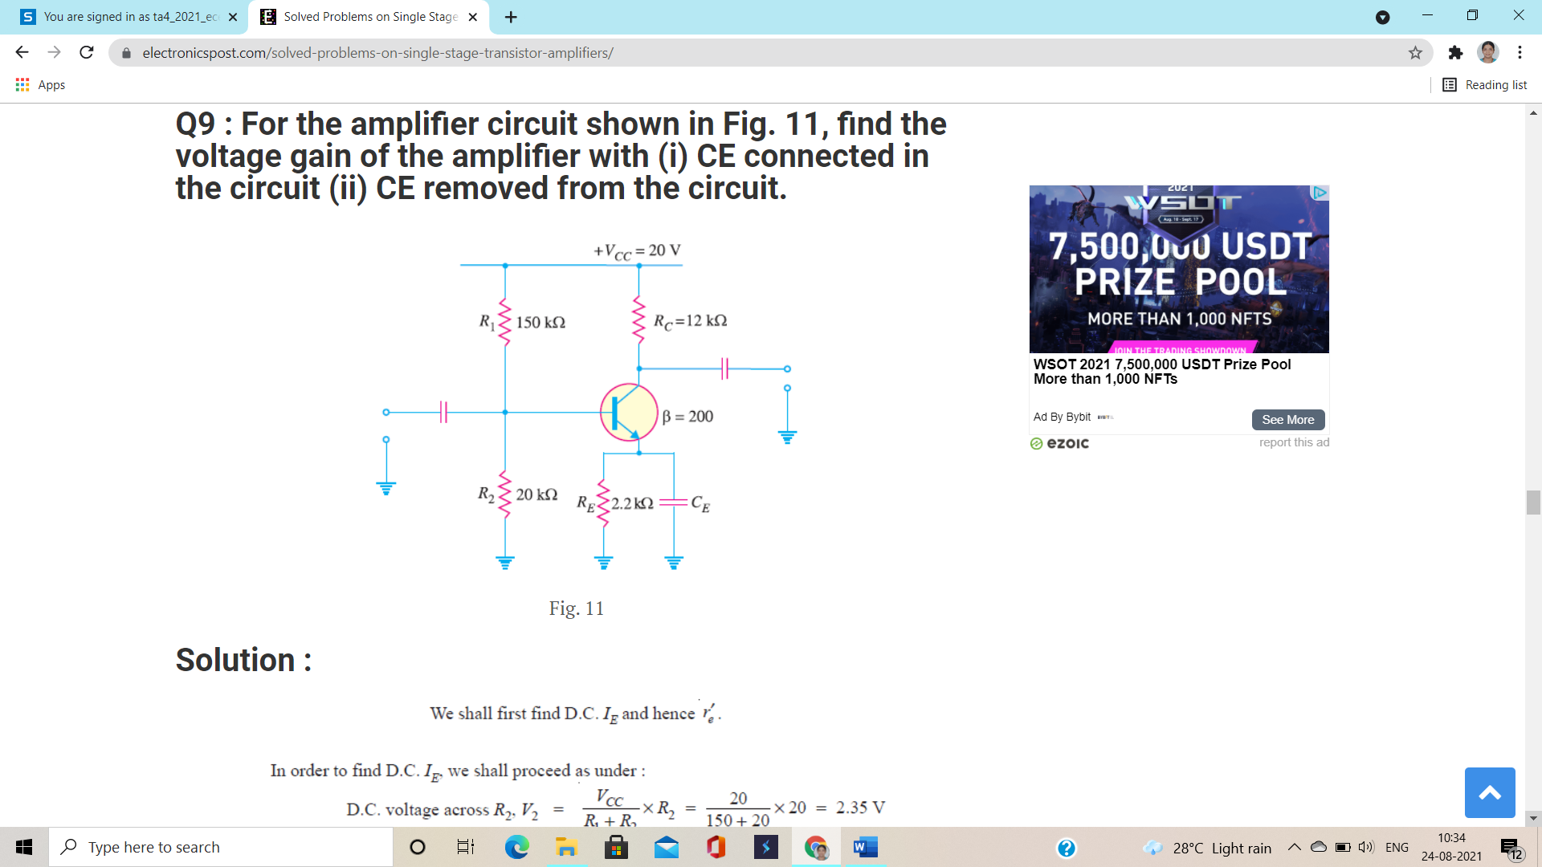
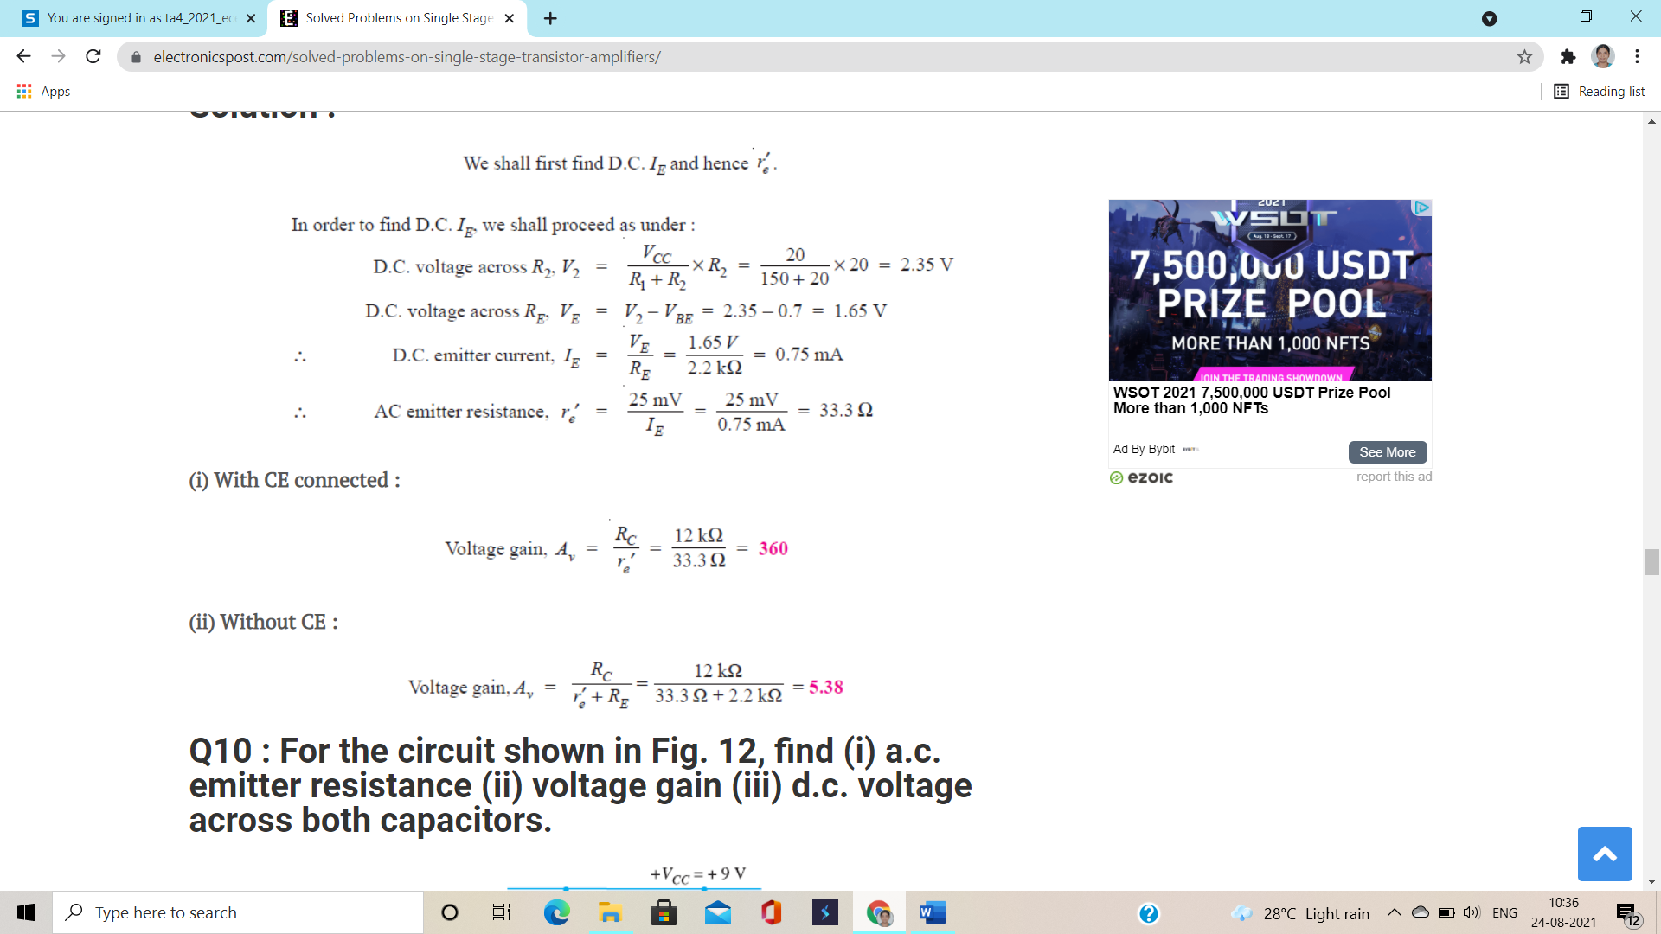
(4)
For the amplifier circuit shown find the voltage gain of the amplifier with (i) CE connected in the circuit (ii) CE removed from the circuit
wn find the voltage gain of the amplifier with (i) CE connected in the circuit (ii) CE removed from the circuit

Slide 7
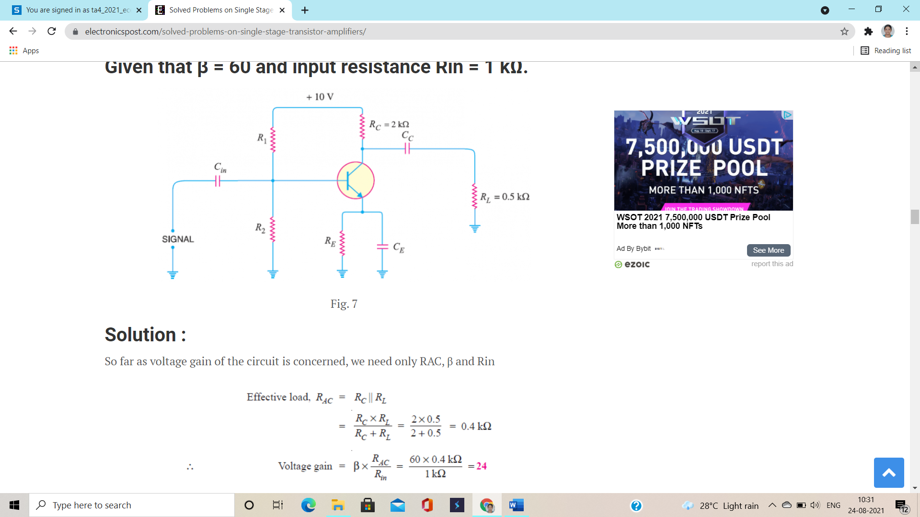
(5)
In the circuit shown find the voltage gain. Given that β=60 and input resistance Rin=1 k

Slide 8
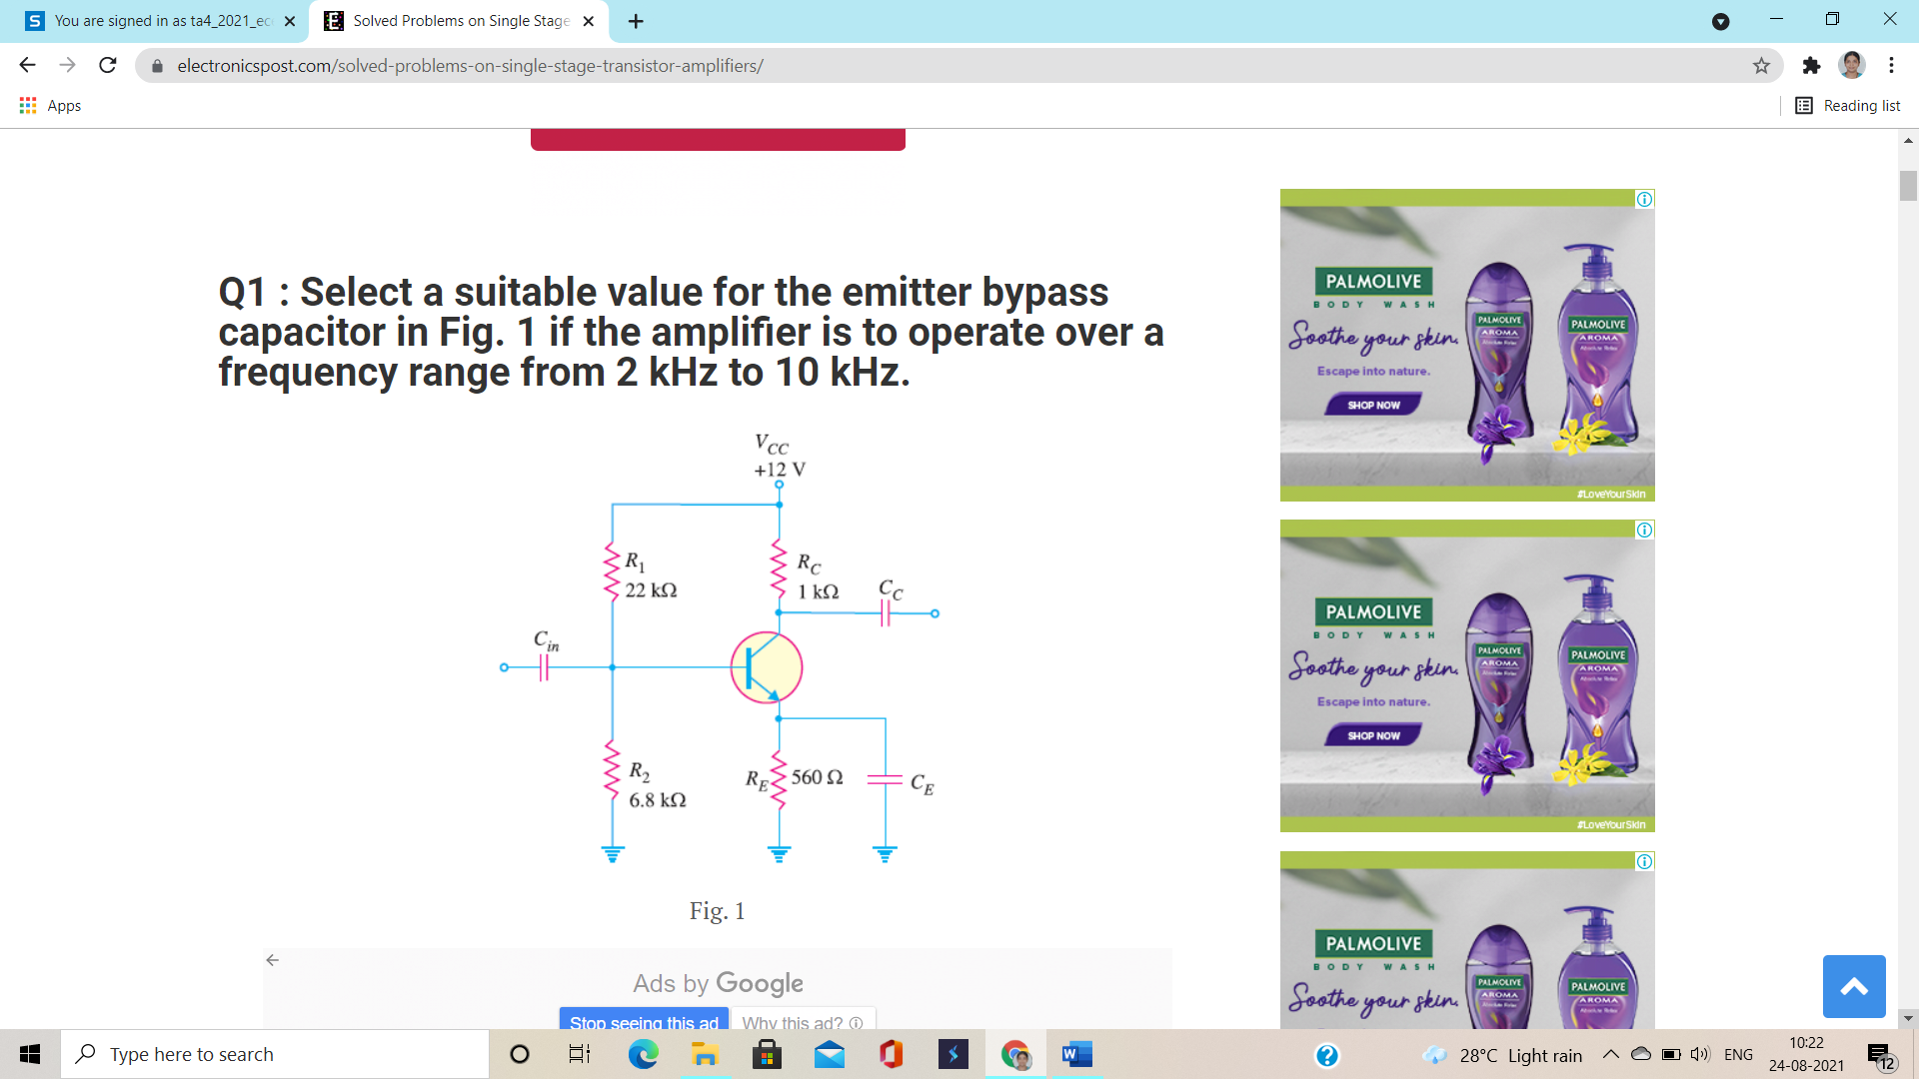
(6) Select a suitable value for emitter bypass capacitor in Fig shown if the amplifier is to operate over a frequency range from 2 kHz TO 10 kHz

Slide 9
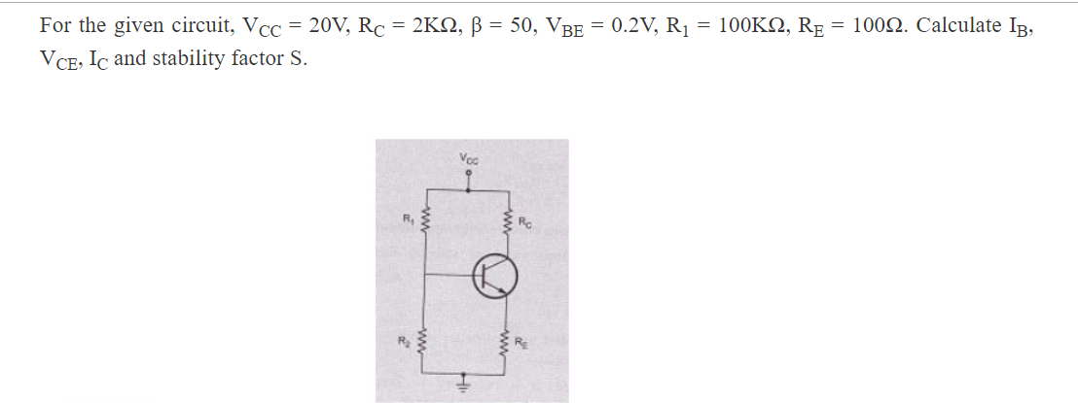
(7)

Slide 10
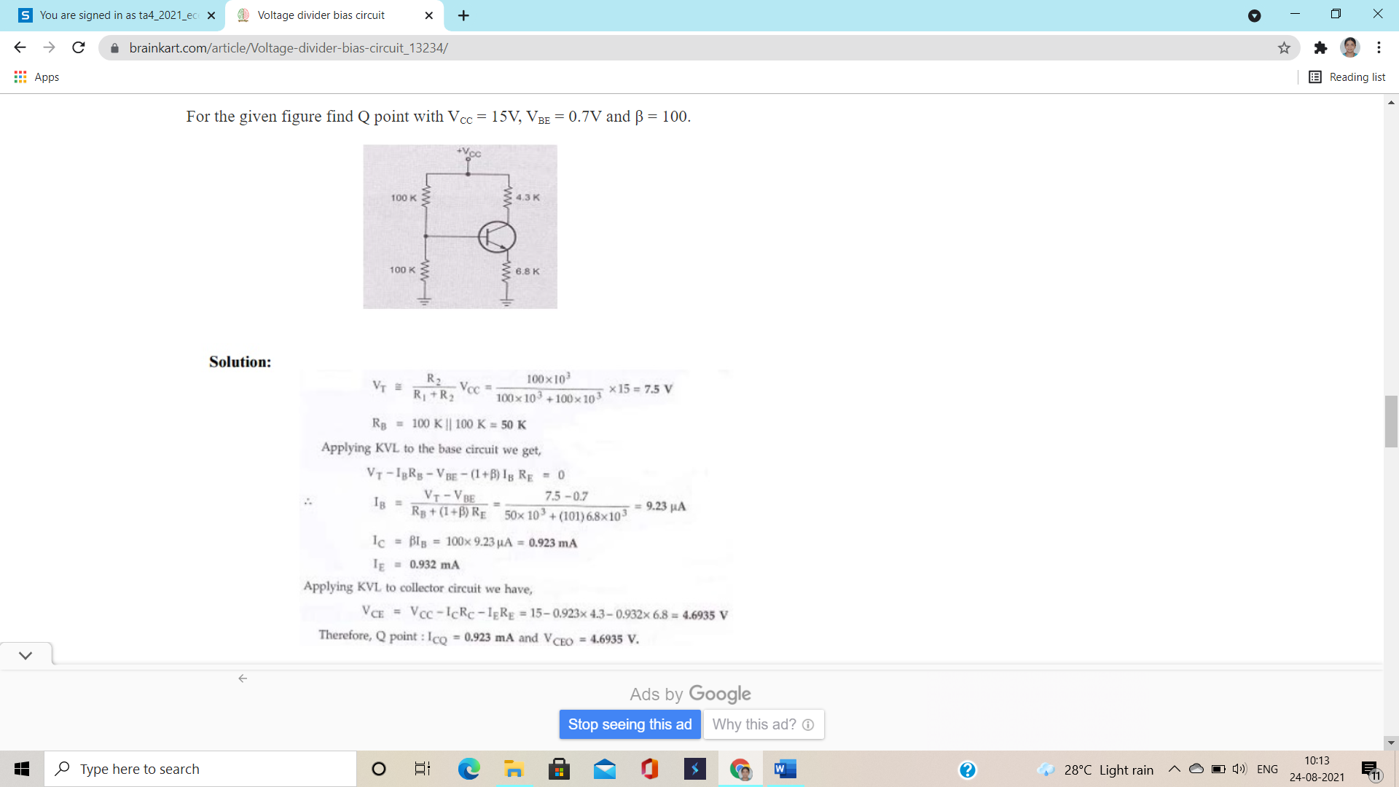
(8)

Slide 11
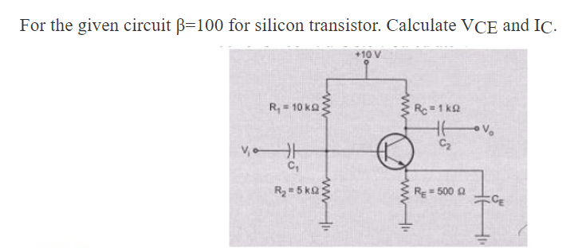
(9)

Slide 12
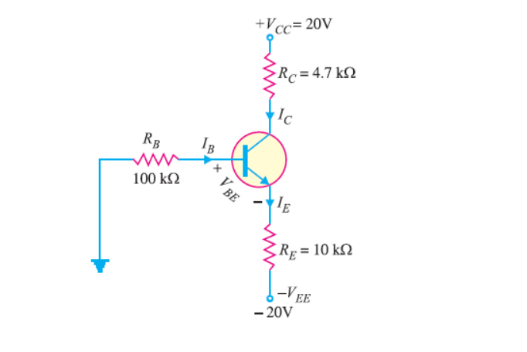
(10) For the emitter biased circuit shown Find IE, IC, VC, and VCE for β= 85 and VBE=0.7V

